Slide 1
NLP CASE STUDY
MARKET BASKET ANALYSIS
9183 HIMANSHU BHUNDERE
9180 AMEY BAGWE
9182 ABHAY BHOSALE

Slide 2
TITLE | Pre-training of Context-aware Item Representation for Next Basket Recommendation
METHODOLOGY | In the offline phase, IERT pre-trains deep item representations conditioning on their transaction contexts. In the online recommendation phase, the pre-trained model is further fine-tuned with an additional output layer. The output contextualized item embeddings are used to capture users' sequential behaviors and general tastes to conduct recommendation.
FINDINGS/OUTCOMES | Experimental results on the Ta-Feng dataset show that IERT outperforms the state-of-the-art baseline methods, demonstrating the effectiveness of IERT in next basket representation The proposed approach of conducting context-aware item representation using IERT showed superior performance compared to existing deep learning methods that use static item representations.

Slide 3
TITLE | Direct-Indirect Association Rule Mining for Online Shopping Customer Data using Natural Language Processing
METHODOLOGY | Deep parsing using NLP is employed to evaluate the semantic and sentiment of the provided text. This analysis is used in conjunction with the analysis of direct and indirect association rules. NLP tokenization is utilized in order to evaluate the relationship of implicit associations.
FINDINGS/OUTCOMES | The existing techniques for analyzing customer feedback have ignored the switch over of products within the same category, which can affect accurate predictions. The paper suggests that the Apriori algorithm alone may not accurately predict which other products a person would buy along with a specified product based solely on basket data. The research work incorporates sentiment analysis, which involves the use of NLP, text analysis, and computational linguistics to systematically identify, extract, quantify, and study affective states and subjective information in customer reviews

Slide 4
TITLE | Applying Natural Language Processing (NLP) Based Metadata Extraction to Automatically Acquire User Preferences
METHODOLOGY | In the offline phase, IERT pre-trains deep item representations conditioning on their transaction contexts. In the online recommendation phase, the pre-trained model is further fine-tuned with an additional output layer. The output contextualized item embeddings are used to capture users' sequential behaviors and general tastes to conduct recommendation.
FINDINGS/OUTCOMES | The paper presents a metadata extraction technique based on NLP and ML that extracts personalized information from email communications between financial analysts and their clients. It extracts both explicit and implicit metadata elements, including proper names, numeric concepts, and topic/subject information. The overall accuracy and coverage of extracting explicit and implicit metadata is about 90%

Slide 5
TITLE | Represent Items by Items: An Enhanced Representation of the Target Item for Recommendation
METHODOLOGY | CER (Co-occurrence based Enhanced Representation) enhances the representation of the target item by distilling relevant information from co-occurrence items. Sampling strategies are used to select a fixed number of co-occurrence items for noise reduction and computational efficiency. Attention mechanism is applied to selectively adopt the semantic information of the sampled items, considering their different importance to the target item.
FINDINGS/OUTCOMES | Extensive experiments on two public benchmarks demonstrate the effectiveness of CER in improving the performance of ICF methods. CER alleviates this issue by selectively learning semantic information from co-occurrence items, improving the quality of target item embeddings. CER also introduces an attention mechanism to dynamically adjust the weight of each user in the representation.

Slide 6
TITLE | A Simple Convolutional Generative Network for Next Item Recommendation
METHODOLOGY | The network architecture consists of a stack of holed convolutional layers, which efficiently increase the receptive fields without relying on pooling operations. The model utilizes a generative approach to learn high-level representations from both short and long-range item dependencies. The use of residual block structures in recommender systems helps optimize deeper networks.
FINDINGS/OUTCOMES | The model utilizes a stack of holed convolutional layers, which efficiently increase the receptive fields without relying on pooling operations. The use of residual block structures in recommender systems, as demonstrated in the paper, significantly improves the optimization for deeper networks. The dilated convolutional structure employed in the proposed model is more effective in modeling long-range item sequences.

Slide 7
TITLE | Mining Implicit and Explicit Rules for Customer Data Using Natural Language Processing and Apriori Algorithm
METHODOLOGY | Apriori algorithm is used to identify frequent sets of items that are explicitly bought together in order to examine the connection between items sold in a supermarket. Sentiment analysis is used to identify implicit relationships and to identify the object and topic from the text to which the feeling is guided. NLP techniques are utilized to understand customer opinions and reviews written in the Arabic language and convert them into structured data.
FINDINGS/OUTCOMES | Association rule mining is used to establish relationships between items in a transactional database. The work aims to use NLP and the Apriori algorithm to identify both explicit and implicit products for better business opportunities. It also mentions the use of market basket analysis, rule induction technique, and semantic similarity measure for understanding customer behavior and generating rules.

Slide 8
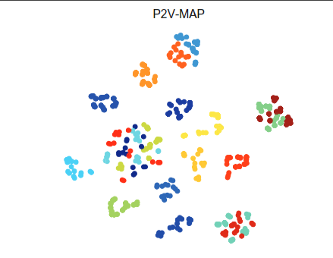
TITLE | P2V-MAP: Mapping Market Structures for Large Retail Assortments
METHODOLOGY | Dimensionality reduction techniques were applied to the latent attributes to create a two-dimensional product map . (PCA, MDS) SG Model (optimizing the ML model) P2V-Mapping
FINDINGS/OUTCOMES | P2V-MAP outperforms other approaches in generating a structured product map and performs significantly better on all benchmarking metrics.

Slide 9
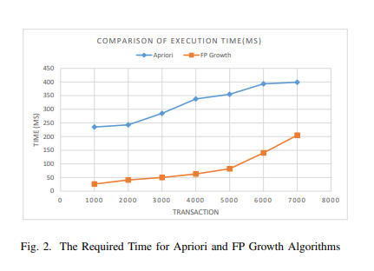
TITLE | Market Basket Analysis Using Apriori and FP Growth Algorithm
METHODOLOGY | Utilizing the Apriori and FP Growth algorithms for market basket analysis to identify frequent itemsets and association rules. A Predefined minimum support to identify frequent itemsets, but when the minimum support is low candidate sets are considered. Focusing on top-selling products in the dataset. The results show that using top-selling items can yield similar outputs in a shorter time compared to computing all items.
FINDINGS/OUTCOMES | Additionally, the paper finds that the FP Growth algorithm takes less time than the Apriori algorithm.

Slide 10
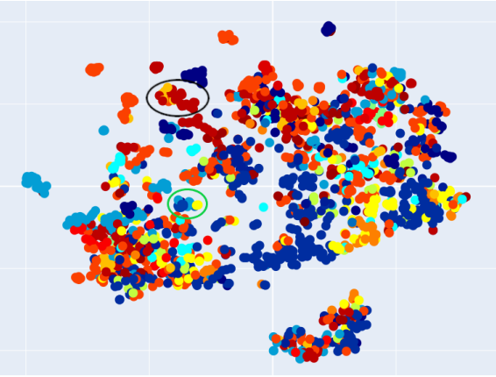
TITLE | ProdBERT: Shopping Basket Completion Using Bidirectional Encoder Representations from Transformers
METHODOLOGY | Utilizes the BERT architecture, which consists of multiple bidirectional Transformer encoders, for market analysis and basket completion tasks. ProdBERT, the model introduced in the paper, pre-trains the BERT architecture using product baskets as 'sentences' and product IDs as 'words' for masked language modeling. It also trains itself by splitting baskets into two parts for next sentence prediction. Fine Tuning and Segment Embedding
FINDINGS/OUTCOMES | the paper demonstrates the application of more sophisticated deep-learning methods to marketing, improving on existing r results and paving the way for using more fitting models in the same task

